Slide 1
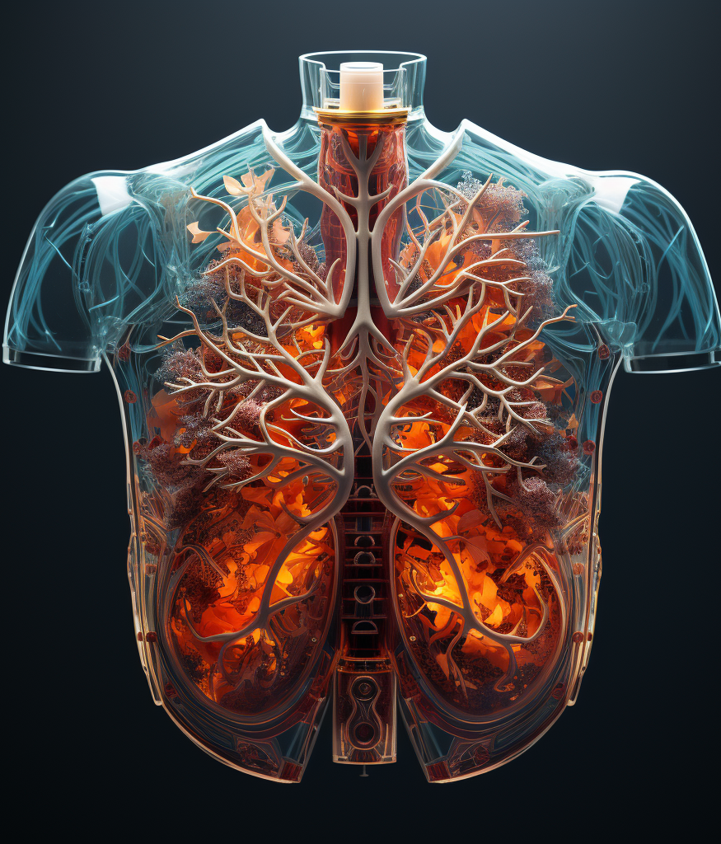
KAFKA Challenge
Speicherung der aktuellen Trends auf Wikipedia und historischen Veränderungen von Themen mittels Apache Kafka.
Notes:
Welcome to my talk on my master thesis named: Are interpretable models better than post-hoc explanation methods in detecting shortcut learning.
So as the name suggests, we have a problem or phenomena called shortcut learning and we want to compare some methods in detecting the phenomena. But if you dont understand what all that means, I will guide you trough the topic along the way.
As I worked only with medical image data, specifically with chest-x-ray images, I tried to create a theme around it and asked midjourney to create some abstract chest-x-ray images for me, which you can also see on this slide. They dont have any specific meaning, it is just a design choice around my presentation.

Slide 2
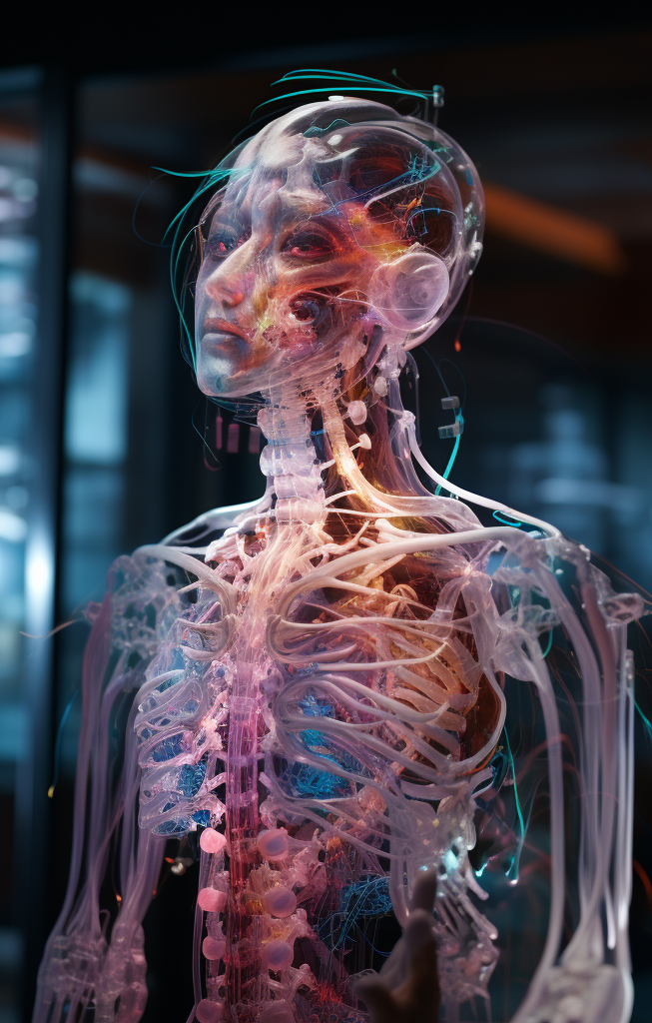
Struktur
Einleitung
Methodik
Prototyp
Aspekte
Notes:
Without further adue, let's dive into the talk. I will start with a short introduction about the topic.
Then i will talk about the method section and experiments & results.
Finally I will conclude.
---
where I talk about how I actually analyzed certain methods, which methods I actually analyzed and the final results of my experiments.
---

Slide 3

Einleitung
Notes:
I want to give a short introduction and want to start with the problem at hand, namely shortcut learning

Slide 4
Herangehensweise

Slide 5

methodik
Notes:
Explain the Synthetic Evaluation Strategy we use to evaluate the explanation methods.

Slide 6
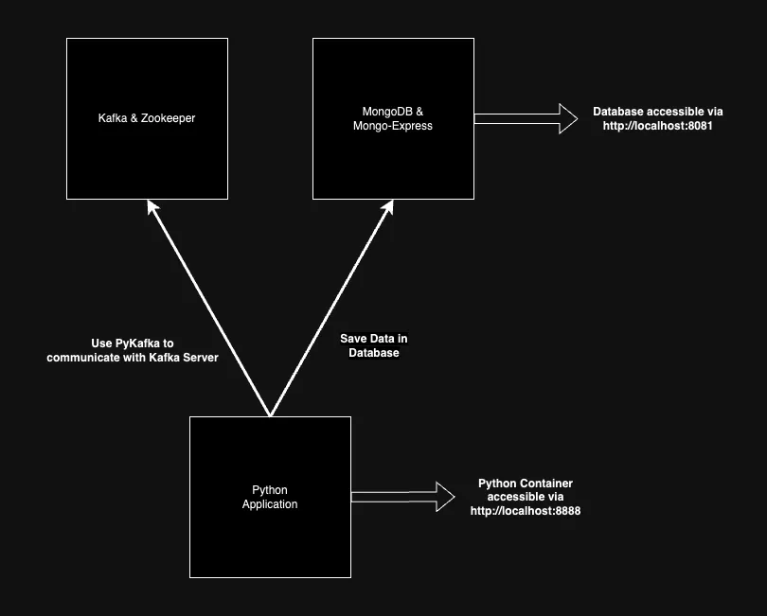
Idee

Slide 7
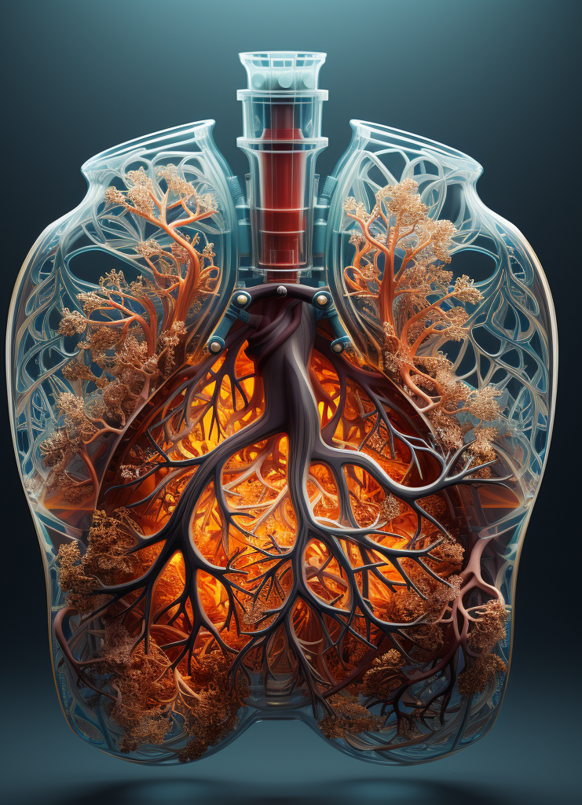
Prototyp
Notes:
Ok, lets now finally talk about some experiments & results.

Slide 9

Aspekte
Notes:
Ok lets wrap things up!

Slide 11

Vielen Dank für Die Aufmerksamkeit!

